Slide 1


CSE332: Data Abstractions Section 2
HyeIn Kim
Winter 2013

Slide 2
Section Agenda
Bugs & Testing
Induction Review
Recurrence Relations
Asymptotic Analysis
Homework Tips & Questions

Slide 3
Bugs & Testing

Slide 4


Bugs & Testing
Software Bugs
- Error in a computer
program
- Causes program to
behave in unexpected
ways

Slide 5
Bugs & Testing
Why Testing?
Bugs can be costly
- Cost points in homework
- Can cost $$$ and even life (Therac-25)
Interesting Bug References
- List of bugs http://en.wikipedia.org/wiki/List_of_software_bugs
- History’s /worst http://www.wired.comsoftware/coolapps/news/2005/11/69355?currentPage=all
- Bugs of the month http://www.gimpel.com/html/bugs.htm

Slide 6
Bugs & Testing
Reverse.java
does not test your stack!!
- Stack can still have lots of bugs
when working perfectly with Reverse.java
- Some extreme case in past quarter:
it only worked with Reverse.java
(Not a good stack!)

Slide 7
Bugs & Testing
Tips for Testing
- Make sure program meets the spec
- Test if each method work
- Test if methods work together
- Test for edge cases

Slide 8
Bugs & Testing
Make sure program meets the spec
- What is wrong with this implementation?
public class ListStack implements DStack {
private LinkedList<Double> myStack;
public ListStack() {
myStack = new LinkedList<Double>();
}
public void push(double d) {
myStack.add(d);
}
…
}

Slide 9
Bugs & Testing
Test if each method works
- Four public methods
boolean isEmpty()
True if no elements, false otherwise
void push(E elem)
Add element on top of stack
E pop()
Remove & return top element, exception when empty
E peek()
Return (but don’t remove) top element, exception when empty

Slide 10
Bugs & Testing
Test if each method works
Thorough commenting can help
- Think about what each method
is supposed to do
- Check if the method actually does
what you think it should do

Slide 11
Bugs & Testing
Test if methods work together
- Should work in any order
stack.push(3.3)
stack.isEmpty()
stack.push(9.3)
stack.peek()
stack.pop()
stack.push(100)
stack.push(4343)
…

Slide 12
Bugs & Testing
Test for edge cases
- Empty stack
- Push after resizing
- Anything else?

Slide 13
Bugs & Testing
Testing tools: JUnit Testing
- Not required for Project 1
- Required for Project 2
- Covered in section next week

Slide 14
Induction Review

Slide 15
Induction Review
Proof by Induction
- Prove that the first statement in the
infinite sequence of statements is true
(Base case)
- Prove that if any one statement in the
infinite sequence of statements is true,
then so is the next one.
(Inductive case)

Slide 16
Induction Review
Proof by Induction
To prove statement P(n),
- Base Case:
Prove that P(1) is true
- Inductive Case:
Assuming P(k) is true,
prove that P(k+1) is true

Slide 17
Recurrence Relations

Slide 18
Recurrence Relations
Recursively defines a Sequence
- Example: T(n) = T(n-1) + 3, T(1) = 5
^ Has T(x) in definition
Solving Recurrence Relation
- Eliminate recursive part in definition
= Find “Closed Form”
- Example: T(n) = 3n + 2

Slide 19
Recurrence Relations
Expansion Method example
- Solve T(n) = T(n-1) + 2n – 1, T(1) = 1
T(n) = T(n-1) + 2n – 1
T(n-1) = T([n-1]-1) + 2[n-1] – 1
= T(n-2) + 2(n-1) – 1
T(n-2) = T([n-2]-1) + 2[n-2] – 1
= T(n-3) + 2(n-2) – 1

Slide 20
Recurrence Relations
Expansion Method example
T(n) = T(n-1) + 2n – 1
T(n-1) = T(n-2) + 2(n-1) – 1
T(n-2) = T(n-3) + 2(n-2) – 1
T(n) = [T(n-2) + 2(n-1) – 1] + 2n – 1
= T(n-2) + 2(n-1) + 2n – 2
T(n) = [T(n-3) + 2(n-2) – 1] + 2(n-1) + 2n – 2
= T(n-3) + 2(n-2) + 2(n-1) + 2n – 3

Slide 21
Recurrence Relations
Expansion Method example
T(n) = T(n-1) + 2n – 1
T(n) = T(n-2) + 2(n-1) + 2n – 2
T(n) = T(n-3) + 2(n-2) + 2(n-1) + 2n – 3
…
T(n) = T(n-k) + [2(n-(k-1)) + … + 2(n-1) + 2n] – k
= T(n-k) + [2(n-k+1) + … + 2(n-1) + 2n] – k

Slide 22
Recurrence Relations
Expansion Method example
T(n) = T(n-k) + [2(n-k+1) + … + 2(n-1) + 2n] – k
When expanded all the way down, T(n-k) = T(1)
n-k = 1, k = n-1
T(n) = T(n-[n-1]) + [2(n-[n-1]+1) + … + 2(n-1)
+ 2n] – [n-1]
= T(1) + [2(2) + … + 2(n-1) + 2n] – n + 1

Slide 23
Recurrence Relations
Expansion Method example
T(n) = T(1) + [2(2) + … + 2(n-1) + 2n] – n + 1
= T(1) + 2[2 + … + (n-1) + n] – n + 1
= T(1) + 2[(n+1)(n/2) -1] – n + 1
= T(1) + (n+1)(n) - 2 – n + 1
= T(1) + (n²+n) – n - 1
= T(1) + n² – 1
= 1 + n² – 1
= n²

Slide 24
Recurrence Relations
Expansion Method example Check it!
T(n) = T(n-1) + 2n – 1, T(1) = 1
T(n) = n²
T(1) = 1 same as 1²
T(2) = T(1) + 2(2) – 1 = 4 same as 2²
T(3) = T(2) + 2(3) – 1 = 9 same as 3²
T(4) = T(3) + 2(4) – 1 = 16 same as 4²

Slide 25
Asymptotic Analysis

Slide 26
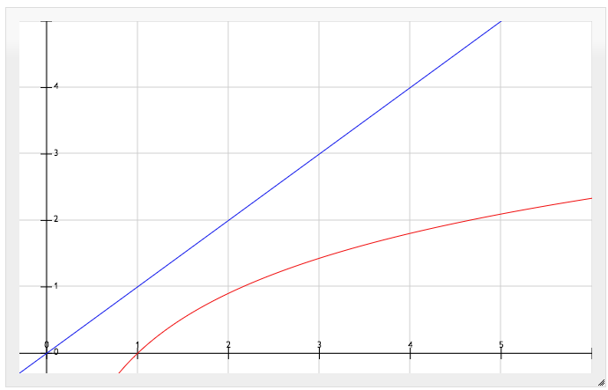
Asymptotic Analysis
Describe Limiting behavior of F(n)
- Characterize growth rate of F(n)
- Use O(g(n)), Ω(g(n)), Θ(g(n)) for set of functions
with asymptotic behavior , ,  &  to g(n)
Upper Bound: O(n)
f(n) ∈ O(g(n)) if and only if
there exist positive constants
c and n₀ such that
f(n)  c*g(n) for all n₀  n
log n ∈ O(n)

Slide 27
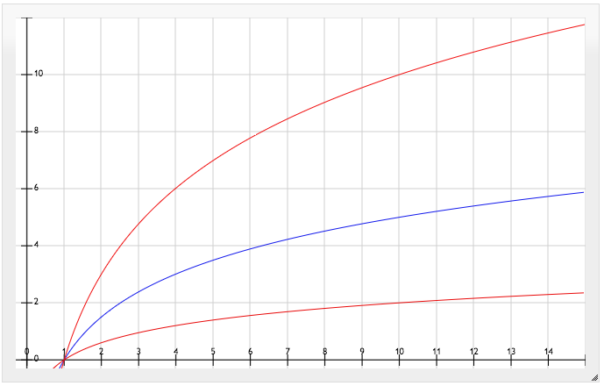
Asymptotic Analysis
Lower Bound: Ω(n)
f(n) ∈ Ω(g(n)) if and only
if there exist positive constants
c and n₀ such that
c*g(n)  f(n) for all n₀  n
Tight Bound: Θ(n)
f(n) ∈ Θ(g(n)) if and only if
f(n) ∈ Ω(g(n)) and
f(n) ∈ O(g(n))
n ∈ Ω(log n)
5*log₁₀ n ∈ Θ(log n)

Slide 28
Asymptotic Analysis
Ordering Growth rates (k = constant)
- Ignore Low-Order terms & Coefficients
O(k) constant
O(log n) logarithmic
Increasing
O(n) linear Growth rate
O(n^{k}) polynomial
O(k^{n}) exponential (k > 1)

Slide 29
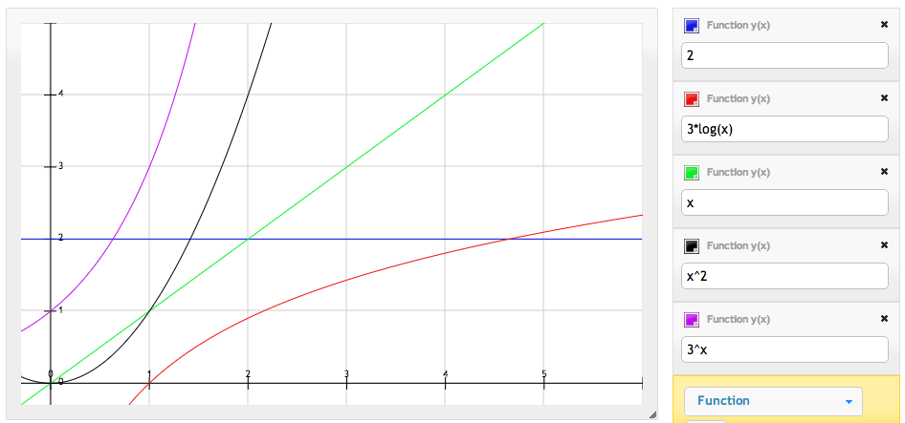
Asymptotic Analysis
Ordering Growth rates

Slide 30
Asymptotic Analysis
Ordering Growth rates
- log^{k}n ∈ O(n^{b}) if 1 < k & 0 < b
- n^{k} ∈ O(b^{n}) if 0 < k & 1 < b
Ordering Example
2n¹⁰⁰ + 10n
2^{n/100} + 2^{n/270}
1000n + log⁸ n
23785n^{1/2}
1000 log¹⁰n + 1^{n/300}
n¹⁰⁰
4
2^{n/100}
5
n
3
n^{1/2}
2
log¹⁰n
1

Slide 31
Asymptotic Analysis
Proof Example: f(n) ∈ O(g(n))
- Prove or disprove nlog n ∈ O(3n)
nlog n ∈ O(3n)
nlog n  c*(3n), for 0 < c && 0 < n₀  n
(1/3)log n  c
but as n → ∞, log n → ∞
Finite constant c always greater than log n
cannot exist, no matter what n₀ we choose
nlog n ∉ O(3n)

Slide 32
Homework Tips

Slide 33
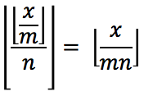
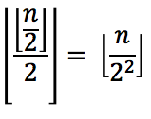

Homework Tips
Problem #1
- Use formula in the book
(You don’t have to derive it by yourself)
Problem #2
- Use following rules:
1. which means
2.

Slide 34
Homework Tips
Problem #3
- f(n) x 10⁻⁶ sec  t sec, solve for n
Problem #4
- Remember that when you are proving
P(k+1), you are assuming P(k)
no matter how silly it is!
- Find flaw in inductive reasoning

Slide 35
Homework Tips
Problem #5
- Use definitions and show you can/cannot
find the constant c
Problem #6
- Analyze runtime of each loop & merge
when appropriate
- Practice finding exact runtime when you can
- Think about maximum iteration of each loop

